Slide 1
Handwritten Character Recognition using Convolutional Neural Network
Presented By: Seif Sameh |Omar Elmelegy
Supervised By: Dr. Mohamed Gamal

Slide 2
List of content
The challenge
Traditional Approaches vs Deep Learning
Tools & Dataset specifications
Convolutional Neural Networks
Key layers & Suggested Architecture
Image Preprocessing
Code Review & Evaluation

Slide 3
Abstract
This project details a character recognition system leveraging Convolutional Neural Networks (CNNs) for feature extraction and classification.
Objective: Accurately identify handwritten digits (0-9) and uppercase letters (A-Z) from a filtered EMNIST Byclass dataset (36 classes total).
Notes:
Focus on the CNN-based approach for the 36-class EMNIST subset, highlighting methodology and key results from the project.

Slide 4
Methodology & Achievement
Methodology: Involves image preprocessing, CNN architecture design tailored for 36 classes, training with Adam optimizer and Categorical Cross-Entropy loss.
Key Achievement: Attained a test accuracy of approximately 92.06% with the suggested CNN model.
Further Exploration: Class imbalance within the dataset was investigated, including an experimental model trained with class weights.
Notes:
Focus on the CNN-based approach for the 36-class EMNIST subset, highlighting methodology and key results from the project.

Slide 5

The Challenge: Handwritten Character Recognition
Importance: Character recognition is a cornerstone of Digital Signal Processing (DSP), vital for Optical Character Recognition (OCR), automation of data entry, and digitization of documents.
Challenges: Significant variability in handwriting styles, presence of noise, and image distortions make it a complex task.
Demand: Requires robust and highly accurate methods for reliable identification across diverse character sets.
Notes:
Introduce the importance and inherent difficulties of handwritten character recognition.

Slide 6
Project Objective & Scope
Primary Objective: To accurately identify handwritten digits (0-9) and uppercase English letters (A-Z) using a filtered subset of the EMNIST Byclass dataset (total 36 classes).
Technological Focus: Leverage Deep Learning, specifically Convolutional Neural Networks (CNNs), for end-to-end character recognition.
Hardware challenge: Excluded lower case letters due to complexity & performance issues (our python kernel kept crashing due to GPU memory shortage)
Scope of Work:
- Design and implement a CNN architecture suitable for the 36-class character set.
- Train and evaluate the CNN model on the EMNIST data.
- Analyze model performance, including per-class accuracy and challenges like class imbalance.
Notes:
Clearly define the main goal of the project and the specific dataset and techniques employed.

Slide 7
Traditional Approaches
Template Matching: Compares input images to predefined character templates.
- Pros: Computationally efficient in classification, simple concept.
Manual Feature Engineering: Techniques like Histogram of Oriented Gradients (HOG), Local Binary Patterns (LBP) extract features, followed by classifiers (e.g., SVM). (General Knowledge)
- Pros: Can be effective if features are well-chosen. (General Knowledge)
- Cons: Feature engineering is often complex, time-consuming, and may not capture optimal representations.
- Cons: Lacks robustness against variations in style, scale, and rotation; sensitive to noise.
Notes:
Briefly discuss older methods and their limitations to set the stage for deep learning.

Slide 8
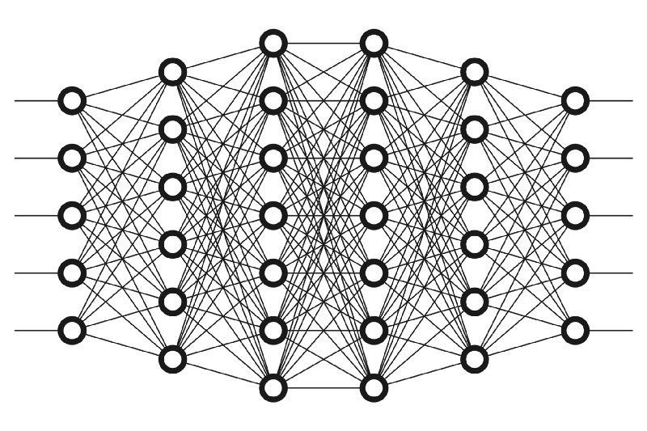
Deep Learning Approaches
Revolutionized image processing by learning hierarchical features directly from raw pixel data.
End-to-End Learning: Models can learn both feature extraction and classification simultaneously. (General Knowledge)
Key Architectures for Recognition Tasks: (General Knowledge)
Multilayer Perceptrons (MLPs): Basic neural networks, can work on flattened images but lose spatial info.
Recurrent Neural Networks (RNNs): Suited for sequential data like online handwriting or text lines.
Convolutional Neural Networks (CNNs): Excel at image-based tasks due to their ability to capture spatial hierarchies. This project's focus.
Notes:
Introduce deep learning as a modern solution, highlighting CNNs as the chosen method.

Slide 9
Typical Deep Learning Workflow
Data Collection & Preparation: Gather, filter (EMNIST byclass), and structure the dataset.
Data Preprocessing: Clean, normalize, augment (if needed), reorient, reshape, and split data (train/validation/test); one-hot encode labels.
Model Design: Define the CNN architecture (layers, activation functions).
Model Training: Feed data to the model, iteratively adjust weights using an optimizer (Adam) and loss function (Categorical Cross-Entropy).
Model Evaluation: Assess performance on unseen test data using metrics (accuracy, per-class analysis).
Tuning & Deployment: Refine model based on evaluation (e.g., address class imbalance), save for future use (e.g., web application).
Notes:
Outline the standard steps involved in a deep learning project, tailored to this project's context.

Slide 10
Key Tools: TensorFlow & Keras
TensorFlow: An open-source library for numerical computation and large-scale machine learning, developed by Google. (General Knowledge)
Version used in this project: 2.19.0.
Keras API: A high-level API integrated within TensorFlow, simplifying the process of building and training neural network models.
Version used: 3.10.0.
Supporting Libraries: NumPy for efficient numerical operations, Matplotlib & Seaborn for data visualization, and Scikit-learn for metrics and data splitting utilities.
Notes:
Describe the primary software tools and libraries utilized in the project.

Slide 11
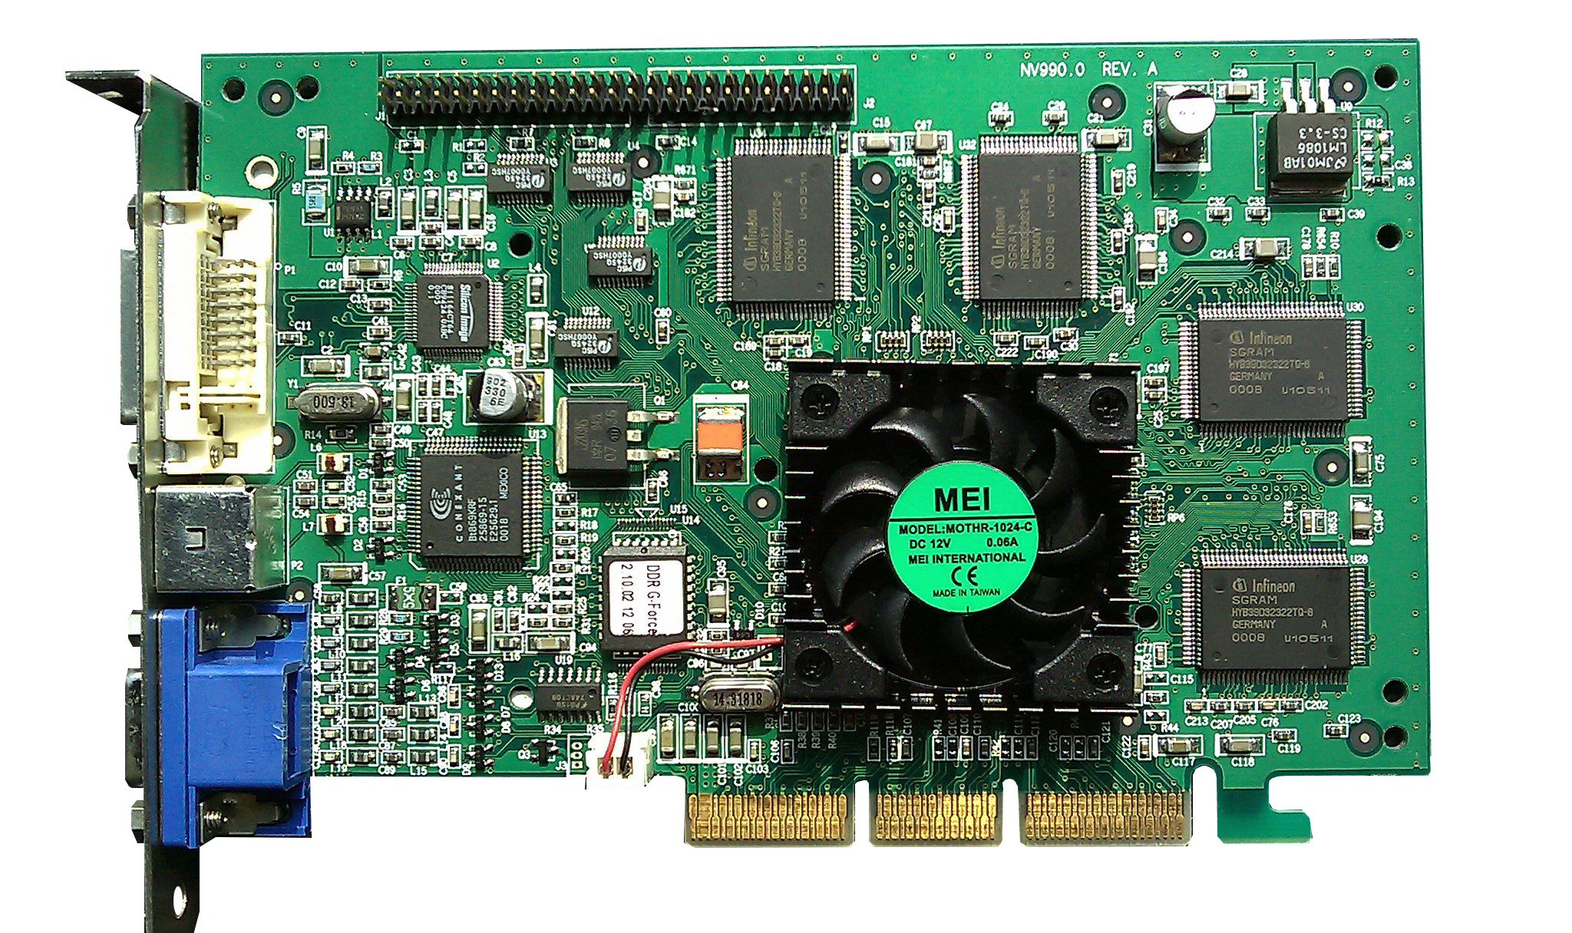
Hardware Acceleration: GPUs
GPUs (Graphics Processing Units) are essential for modern deep learning.
Their parallel processing capabilities significantly accelerate the training of CNNs, which involve numerous matrix computations. (General Knowledge)
Benefits:
Drastically reduced training times for large datasets and complex models.
Enables experimentation with more sophisticated architectures.
Project Utilization: GPU resources were available and utilized for training the CNN model, confirmed by TensorFlow.
Notes:
Explain the importance of GPUs and confirm their use in the project.

Slide 12
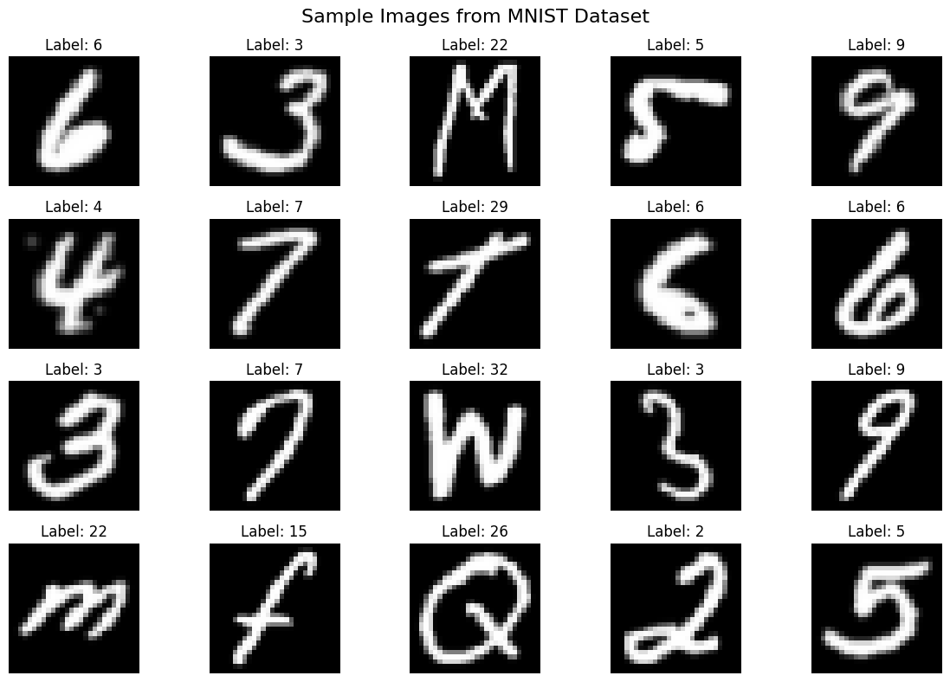
Dataset: EMNIST Byclass (Digits & Uppercase)
Source: EMNIST (Extended MNIST) 'Byclass' dataset, derived from NIST Special Database 19.
Scope: Filtered to 36 classes for this project: Digits (0-9) and Uppercase English letters (A-Z).
Dataset Size (after filtering for 36 classes):
Training samples: 533,992.
Test samples: 89,263.
Image Format: (28*28)-pixel grayscale images.
Note: The dataset exhibits class imbalance, which was considered during the project.
Notes:
Detailed description of the specific EMNIST subset used, its size, and format.

Slide 13
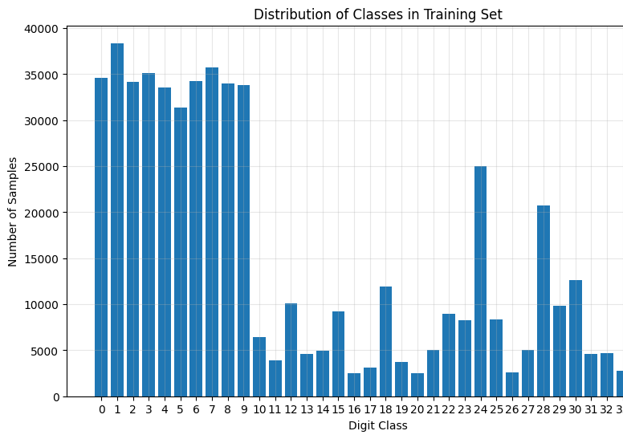
Notes:
Detailed description of the specific EMNIST subset used, its size, and format.

Slide 14
Data Preprocessing Steps
Goal: Standardize input data for optimal CNN performance.
Grayscale: EMNIST images are inherently grayscale.
Normalization: Pixel intensity values scaled from 0-255 to the [0, 1] range.
Reshaping: Images reshaped to (28*28*1) vector to include a channel dimension for CNN input.
Image Orientation: Images rotated and flipped to match standard viewing orientation (as EMNIST raw images can be transposed/flipped).
Label Encoding: Class labels converted to one-hot encoded vectors (e.g., 'A' (class 10) -> [0,..1,..0] for 36 classes).
Notes:
Outline the specific preprocessing steps applied to the EMNIST data.

Slide 15
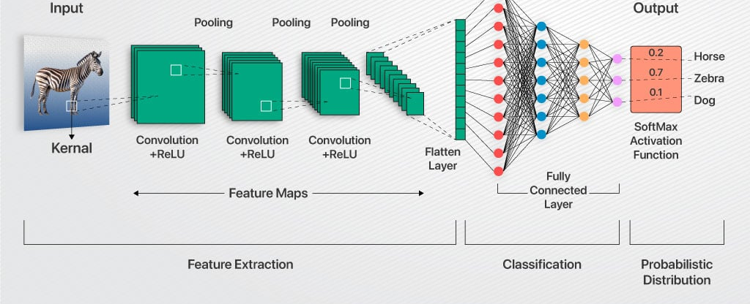
CNNs: An Overview
A type of deep neural network particularly effective for visual imagery.
Key Idea: Employ convolutional layers that apply learnable filters (kernels) to input images, creating feature maps.
These feature maps capture spatial hierarchies of features, from simple edges to complex patterns.
Notes:
Introduce CNNs, their purpose, and basic working principle, as described in the PDF.

Slide 16
Advantages of CNNs for This Task
Hierarchical Feature Learning: Automatically learn relevant visual features (edges, corners, textures) directly from pixel data, eliminating manual feature engineering.
Spatial Invariance: Robustness to variations in character position, scale, and minor distortions due to shared weights and pooling.
Parameter Sharing: Kernels are convolved across the entire image, significantly reducing the number of parameters compared to fully connected networks, leading to more efficient training. (General Knowledge)
Proven Performance: State-of-the-art results in various image recognition tasks, including character recognition.
Notes:
Highlight the specific advantages of CNNs that make them suitable for character recognition.

Slide 17
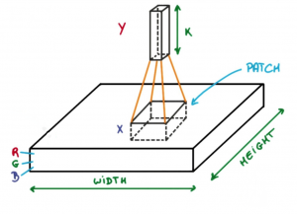
The Convolution Operation
Core of CNNs: Involves sliding a small matrix called a kernel (or filter) over the input image.
At each position, an element-wise multiplication between the kernel and the overlapping input patch is performed, and the results are summed up to produce a single value in the output feature map.
Notes:
Explain the fundamental convolution operation with visual aid suggestions.

Slide 18
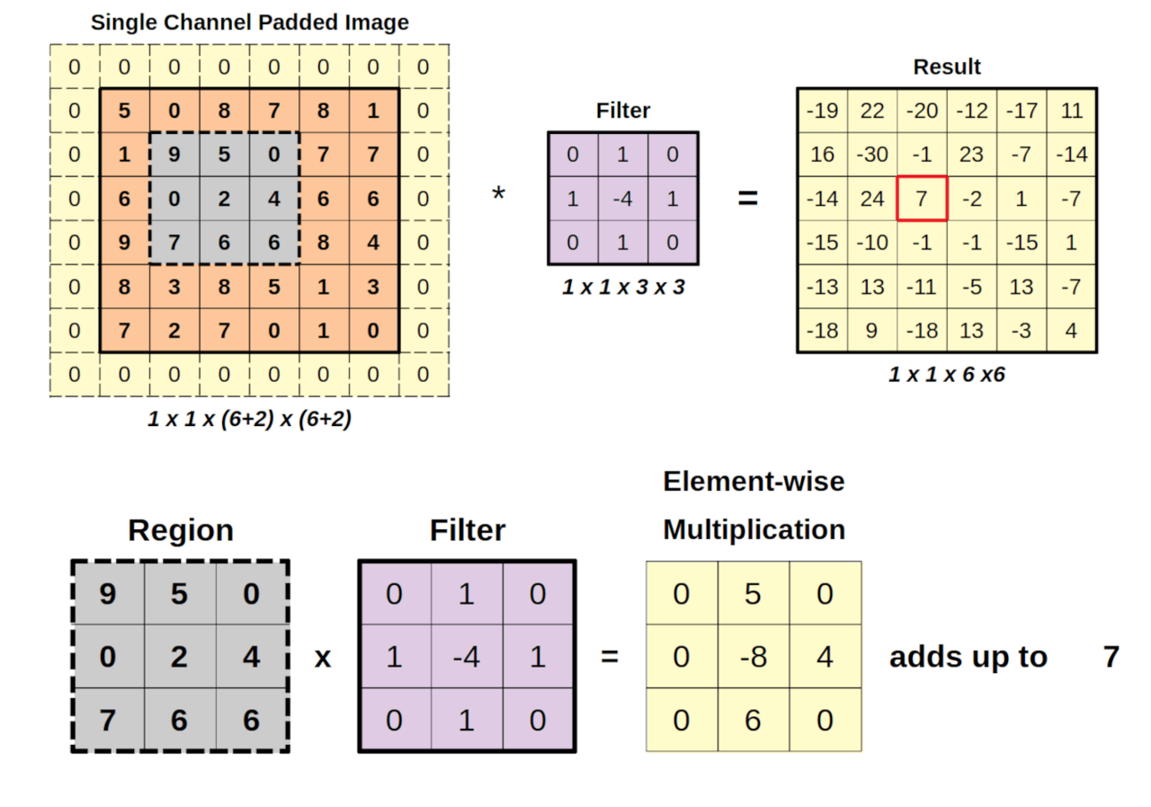
The Convolution Operation (Cont.)
Different kernels can detect different features (e.g., edges, corners).
Note: In deep learning, this is often technically cross-correlation, as kernels are typically not flipped.

Slide 19
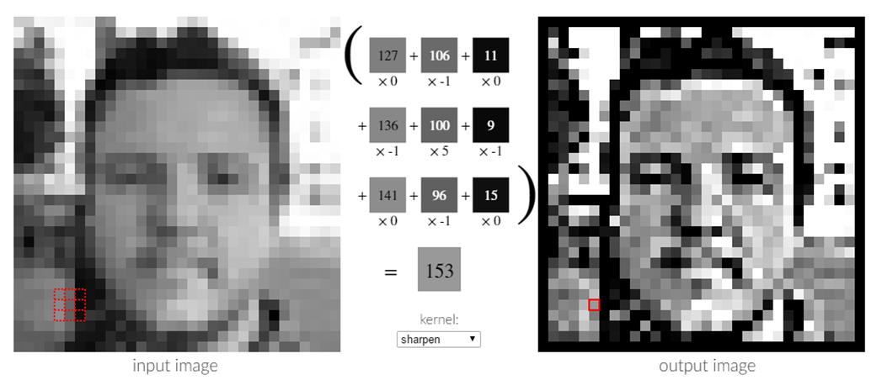
Key CNN Layers
Convolutional Layer: Applies filters (kernels) whose weights are learned during training to extract features.
Input: Image or feature map (e.g., 28*28*1).
Output: Multiple feature maps capturing detected patterns.
Activation Function (ReLU): Typically follows convolutional layers to introduce non-linearity (f(x)=max(0,x)).
Notes:
Describe the Convolutional, ReLU activation, and Max Pooling layers.

Slide 20
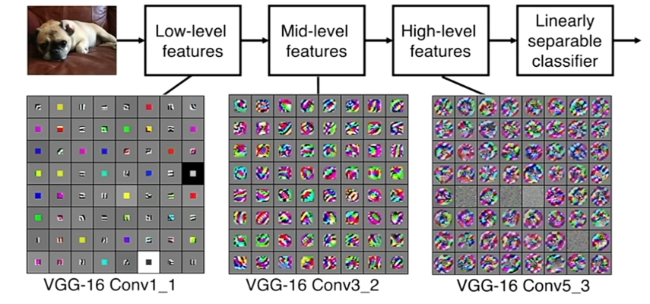
Different kernels in convolution layers

Slide 21
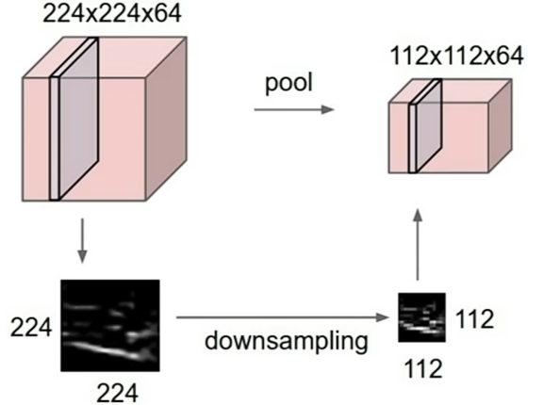
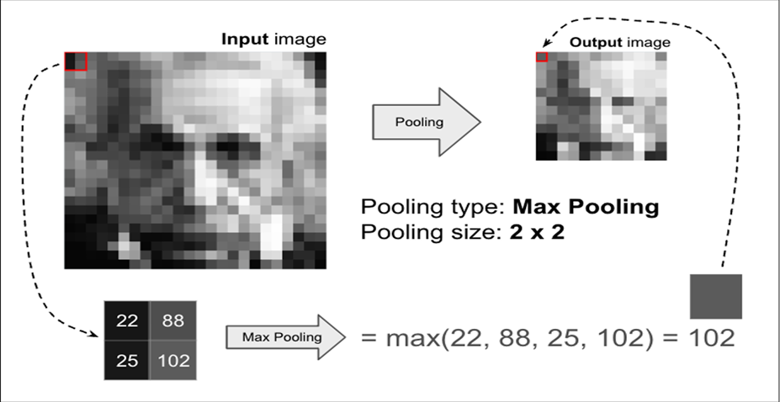
Key CNN Layers (Cont.)
Max Pooling Layer: Reduces spatial dimensions (downsampling) by taking the maximum value from a patch of the feature map, retaining the most prominent features and providing some translation invariance.

Slide 22
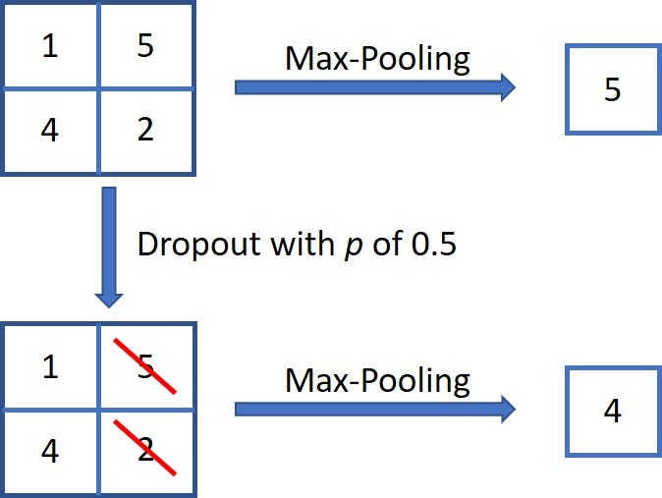
Key CNN Layers (Cont.)
Dropout Layer: A regularization technique to prevent overfitting by randomly zeroing a fraction of neuron outputs during training, forcing the network to learn more robust features.
Standard Dropout: Randomly zeros 25% of elements in feature maps. Less effective in convolutional layers due to spatial correlations.
Spatial Dropout: Drops entire feature maps, forcing the network to rely on diverse features.
Notes:
Explain Dropout, Flatten, and Dense layers, including the output layer with softmax.

Slide 23
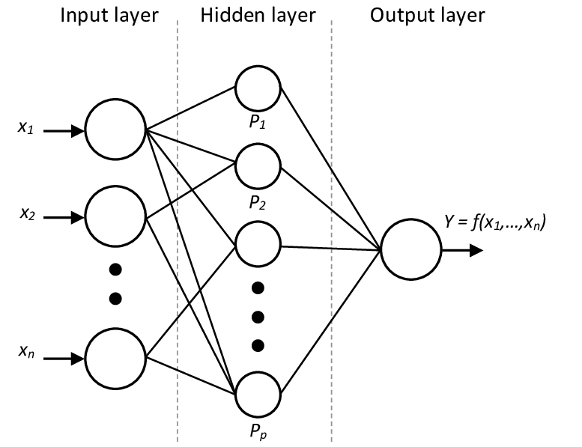
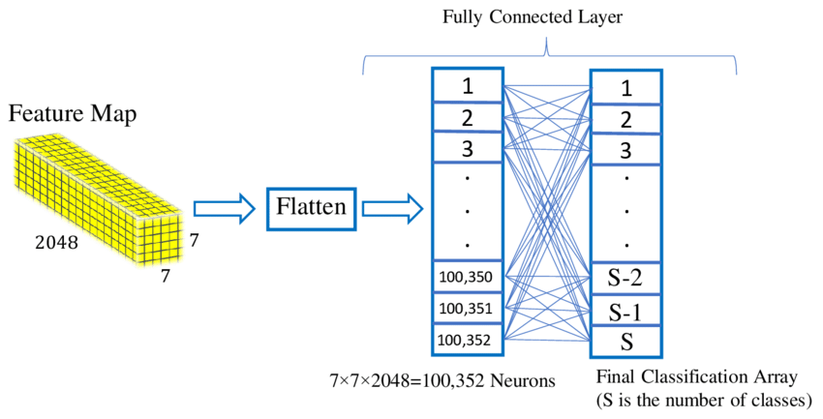
Key CNN Layers (Cont.)
Flatten Layer: Converts the multi-dimensional feature maps from convolutional/pooling layers into a 1D vector, preparing data for fully connected layers.
Dense Layer (Fully Connected Layer): Each neuron is connected to all neurons in the previous layer. Learns global patterns from the flattened features for classification.
Output Layer: A dense layer with a SoftMax activation function is used for multi-class classification, producing probability scores for each class.

Slide 24
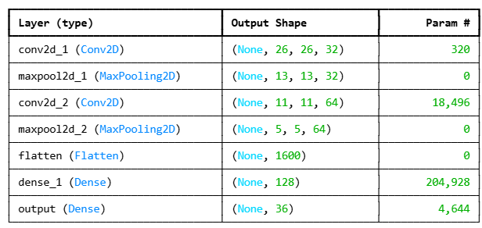
Implemented CNN Architecture (36 Classes)
Tailored for (28,28,1) grayscale EMNIST images (Digits 0-9, Uppercase A-Z):
Total Parameters: 228,388.
Notes:
Detail the specific CNN architecture implemented for the 36-class EMNIST task.

Slide 25
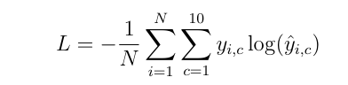
CNN Training Process
Dataset Used: Filtered EMNIST Byclass (Train: 533,992 samples for 36 classes).
Optimizer: Adam (adaptive learning rate optimization algorithm).
Loss Function: Categorical Cross-Entropy (suitable for multi-class classification).
Key Training Parameters:
Epochs: 20
Batch Size: 16
Validation Split: 20% of training data (stratified).
Achieved Results:
Training Accuracy: ~95.26%
Validation Accuracy: ~92.04%
Notes:
Describe the training setup, parameters, and key training metrics achieved.

Slide 26
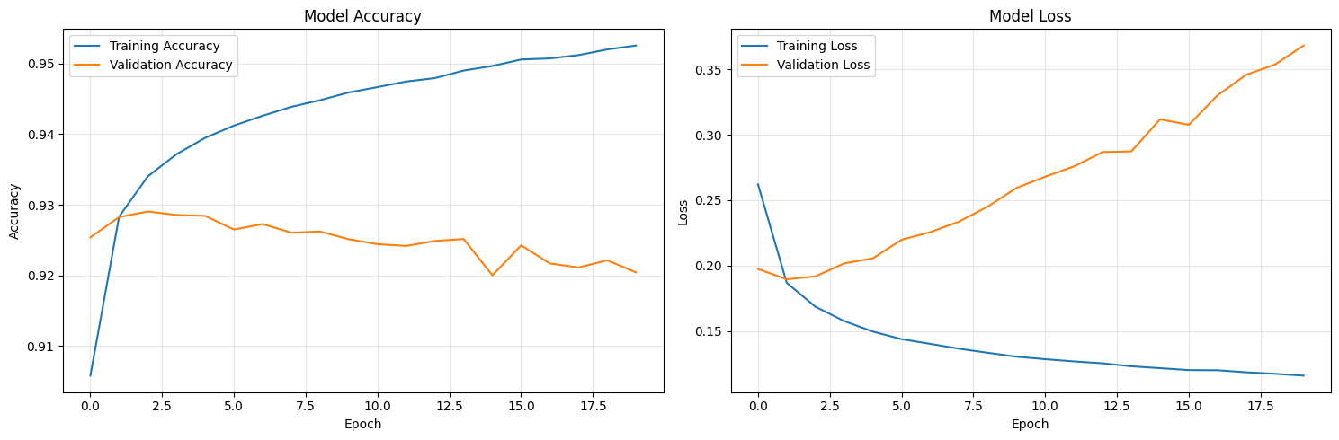
Model accuracy & Loss against Epochs

Slide 27
Code Review

Slide 28
CNN Performance on Test Set
Model Evaluation: The trained CNN model was evaluated on the unseen EMNIST Byclass test set (89,263 images for 36 classes).
Performance Metrics:
Overall Test Accuracy: 92.06%
Overall Test Error Rate: 7.94%
This indicates a strong generalization capability of the model to new, unseen handwritten characters.
Notes:
Present the overall performance of the primary CNN model on the test data.

Slide 29
Discussion: Per-Class Performance & Challenges
Per-class accuracy analysis provided deeper insights:
Strong Performance: Many digit and distinct letter classes showed high accuracy (>95%).
Challenges Identified: Lower accuracies for characters that are visually similar or have fewer training samples.
e.g., '0' (digit zero, ~61.1%) vs 'O' (letter O, ~70.3%)
e.g., 'I' (letter I, ~67.0%) vs '1' (digit one, ~83.8%)
Other challenging letters included 'G' (~84.6%).
Primary Challenge: Inherent class imbalance in the EMNIST dataset, even after filtering to 36 classes. Some characters have significantly more samples than others.
Notes:
Discuss the performance variations across different character classes and highlight the issue of class imbalance.

Slide 30
Conclusion
A CNN was successfully designed, trained, and evaluated for recognizing 36 classes (digits 0-9, uppercase A-Z) from the EMNIST Byclass dataset.
The primary model achieved a robust test accuracy of 92.06%, demonstrating the effectiveness of CNNs for this complex character recognition task.
Key challenges, including visual similarity between certain characters and dataset class imbalance, were identified and analyzed.
Initial experiments with class weighting to address imbalance indicated areas for further refinement and exploration.
The project underscores the power of CNNs in DSP applications like advanced OCR systems.
Notes:
Summarize the key achievements, findings, and overall success of the project.

Slide 31
References
TensorFlow Documentation. (2023). Keras API.
LeCun, Y., Bottou, L., Bengio, Y., & Haffner, P. (1998). Gradient-based learning applied to document recognition. *Proceedings of the IEEE*.
Crawford, G. EMNIST Dataset. Kaggle. (Dataset Source)
Brownlee, J. (Various Dates). Machine Learning Mastery. (General concepts & tutorials).
Notes:
List key references, including the primary PDF report and dataset source.

Slide 32

Thank You! Any Questions ?

